Slide 1
System Software

Slide 2
Agenda
1
Inter Process Communications
2
Signals
3
Multithreading
4
Timers and Resource Limits
5
Memory Management

Slide 3
Inter Process Communications (IPC) Mechanisms
In a multiprocessing environment, often many processes are in need to communicate with each other and share some of the resources.
The shared resources must also be synchronized from the concurrent access by many processes.
IPC mechanisms have many distinct purposes: for example
* Data transfer * Sharing data
* Event notification * Resource sharing
* Process control
Primitive
Unnamed pipe
Named pipe (FIFO)
System V IPC
Message queues
Shared memory
Semaphores
Socket Programming

Slide 4
Pipe Example
Client - Server
STDIN
Path Name
Client
Server
File
STDOUT
File Content or Error
Message

Slide 5
pipe (or unnamed pipe “|”)
On command line pipe is represented as “|”
It can be used in the shell to link two or more commands
For example ls –Rl | wc
Two ends of a pipe is represented as a set of two descriptors.
A pipe is used to communicate between related processes.
Half duplex
Data is passed in order.
Pipe uses circular buffer and it has zero buffering capacity
The read and write system calls are blocking calls.

Slide 6
Pipe – half duplex
read
fd[0]
write
fd[1]
int fd[2];
pipe(fd);
-returns with fd[0], fd[1];
write(fd[1], …………);
read(fd[0], ……….);
Create a pipe.
Call fork.
Parent can send data and child can read the data or vice versa.
Unused ends (descriptors) should be closed.

Slide 7
One way data transfer from related process
One-way communication from parent to child
fd[0] fd[0]
read
Close read end
Child
process
pipe
Parent
process
write
Close write end
fd[1]
fd[1]

Slide 8
Two Way Communication
Create two pipes say fd1, fd2.
Four descriptors for each process (fd1[0], fd1[1], fd2[0], fd2[1]).
Parent closes read end of fd1 and write end of fd2 close(fd1[0], fd2[1]);
child closes read end of fd2 and write end of fd1 close(fd2[0], fd1[1]);
Child
Parent
fd1[1]
fd1[0]
pipe1
pipe2
fd2[0]
fd2[1]

Slide 9
Execution of command: $ ls –Rl | grep ^d | wc -l
Ls –Rl
grep ^d
wc -l
Stdin
Stdout
Stdin
Stdout
Process
kernel
Pipe advantages:
Simplest form of IPC
Persistence in process level
Can be used in shell
Disadvantages:
Cannot be used to communicate between unrelated processes
Pipe1
Pipe2
Flow of data
Flow of data

Slide 10
popen ( ) Library Function
The popen library function opens a process by creating a pipe, execute fork and invoke a shell.
FILE *popen (const char *executable, const char *mode);
On success returns file pointer else NULL (if fork or pipe system calls failed).
int pclose (FILE *STREAM);
Used to read or write to a file at a specified offset value.
Same as read/write except the starting position is from the given offset.
On success the system calls return number of bytes read or written.
If 0 returns
pwrite: nothing has been written
pread: end of file

Slide 11
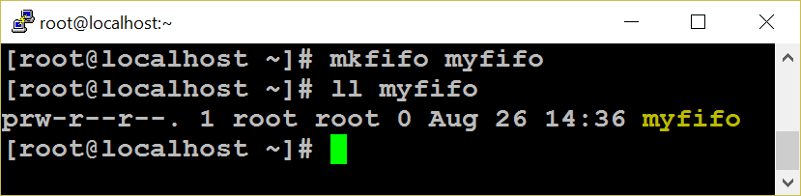
FIFO -Introduction
FIFO can be created in a shell by using mknod or mkfifo command.
mknod myfifo p
mkfifo a=rw myfifo
In a C program mknod system call or mkfifo library function can be used.
int mkfifo ( char *file_name, mode_t mode);
int mknod (char *file_name, mode_t mode, dev_t dev);
mknod(“./MYFIFO", S_IFIFO|0666, 0);
FIFO works much like a pipe
Half duplex, data passed in FIFO order, circular buffer and zero buffering capacity.
FIFO is created on a file system as a device special file
It can be used to communicate between unrelated processes
It can be reused.
Persist till the file is deleted.

Slide 12
FIFO
Once a FIFO is created, you can use file’s related system calls (open, read, write, select, close etc., ) to access the FIFO.
For example: Process 1 may open a FIFO in write only mode and write some data.
Process 2 may open the FIFO in read only mode, read the data and display on the monitor.
FIFO - Disadvantages
Data cannot be broadcast to multiple receivers.
If there are multiple receivers, there is no way to direct to a specific reader or vice versa.
Cannot store data and you cannot use FIFO across network.
Less secure than a pipe, since any process with valid access permission can access data.
No message boundaries. Data is treated as a stream of bytes.

Slide 13
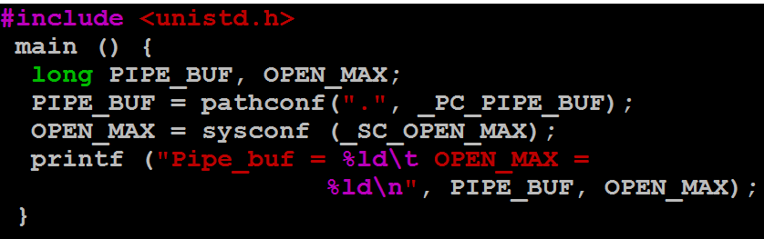
FIFO Limitation
System imposed limits on pipes
Maximum number of files can be open within a process is determined by OPEN_MAX macro.
Maximum amount of data that can be written to a pipe of FIFO atomically is determined by PIPE_BUF macro (size of a circular buffer ).

Slide 14
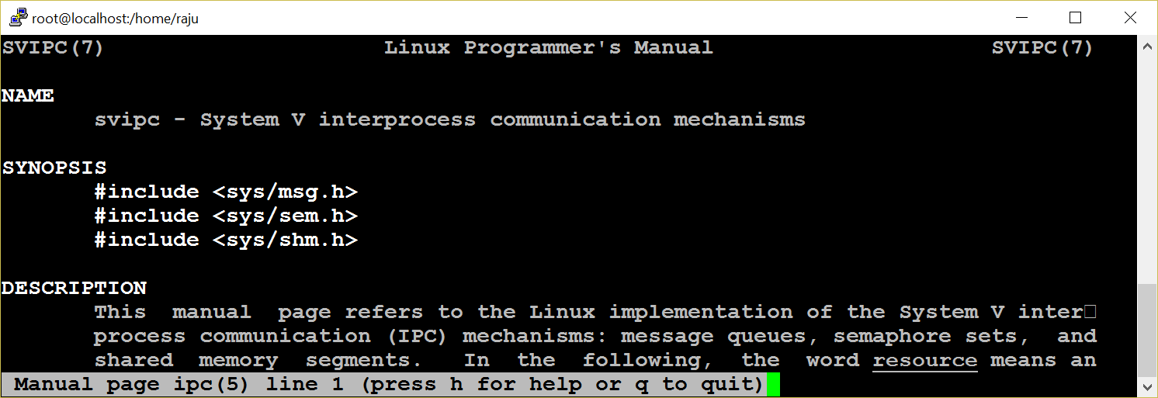
System V IPC
Pipe and FIFO do not satisfy many requirements of many applications.
Sys V IPC is implemented as a single unit
System V IPC Provides three mechanisms namely : MQ, SHM and SEM
Persist till explicitly delete or reboot the system

Slide 15
Attributes
Each IPC objects has the following attributes.
key
id
Owner
Permission
Size
Message queue – used-bytes, number of messages
Shared memory – size, number of attach, status
Semaphore – number of semaphores in a set
The ipc_perm structure holds the common attributes of the resources.
Key:
the first step is to create a shared unique identifier.
The simplest form of the identifier is a number
the system generates this number dynamically by using the ftok library function.
Syntax: key_t ftok (const char *filename, int id);

Slide 16
ID
The syntax for a get function is:
int xxxget (key_t key, int xxxflg);
(xxx may be msg or shm or sem)
If successful, returns to an identifier; otherwise -1 for error.
The key can be generated in three different ways
from the ftok library function
by choosing some static positive integer value
by using the IPC_PRIVATE macro
flags commonly used with this function are IPC_CREAT and IPC_EXCL.
The syntax for the control function is:
int xxxctl (int xxxid, int cmd, struct xxxid_ds *buffer); (xxx may be msg or shm or sem);
If successful, the xxxctl function returns zero, otherwise it returns -1.
The command argument may be
IPC_STAT
IPC_SET
IPC_RMID

Slide 17
Message Q
Message queue overcomes FIFO limitation like storing data and setting message boundaries.
Create a message queue
Send message (s) to the queue
Any process who has permission to access the queue can retrieve message (s).
remove the message queue.
Stuct
msgqid_ds
p
p
Message read from head
New Messages added at tail
msg
msg
msg
p
p

Slide 18
Message Q
struct msgbuf {
long mtype;
char mtext [1];
}; Standard structure
msqid xxx
mtype x₁
msg text
mtype x₂
msg text
mtype x₃
msg text
struct My_msgQ {
long mtype;
char mtext [1024];
void * xyz;
}; Our own structure
mtype x₄
msg text
mtype x₅
msg text
---------
mtype x_{n}
msg text

Slide 19
MQ System Calls
int msgget (key_t key, int msgflg);
The first argument key can be passed from the return value of the ftok function or made IPC_PRIVATE.
To create a message queue, IPC_CREAT ORed with access permission is set for the msgflg argument.
Ex: msgid = msgget (key, IPC_CREAT | 0744);
msgid = msgget (key, 0);
syntax of the function is:
ssize_t msgrcv (int msqid, struct msgbuf *msgp, size_t msgsz, long msgtype, int msgflg);
msgtype argument is used to retrieve a particular message.
0 -retrieve in FIFO order
+ve - retrieve the the exact value of the message type
–ve - first message or <= to the absolute value.
on success, msgrcv returns with the number of bytes actually copied into the message text
The syntax of the function is:
int msgsnd (int msqid, structu msgbuf *msgp, size_t msgsz, int msgflg);
Arguments:
message queue ID, address of the structure.
size of the message text
message flag = 0 or IPC_NOWAIT

Slide 20
MQ System Calls
syntax of the function is:
ssize_t msgrcv (int msqid, struct msgbuf *msgp, size_t msgsz, long msgtype, int msgflg);
msgtype argument is used to retrieve a particular message.
0 -retrieve in FIFO order
+ve - retrieve the the exact value of the message type
–ve - first message or <= to the absolute value.
on success, msgrcv returns with the number of bytes actually copied into the message text
key = ftok (“.“, ‘a‘);
msqid = msgget (key, IPC_CREAT|0666);
msgsnd (msqid, &struct, sizeof (struct), 0);
msgrcv (msqid, &struct, sizeof (struct), mtype, 0);
msgctl (msqid, IPC_RMID, NULL);
$ipcrm msg msqid

Slide 21
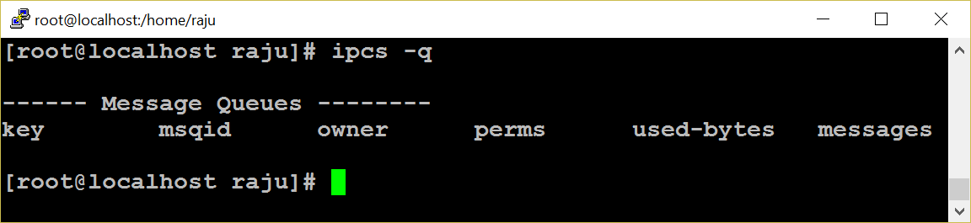
MQ Limitations
Message queues are effective if a small amount of data is transferred.
Very expensive for large transfers.
During message sending and receiving, the message is copied from user buffer into kernel buffer and vice versa
So each message transfer involves two data copy operations, which results in poor performance of a system.
A message in a queue can not be reused

Slide 22
Shared Memory - Introduction
Very flexible and ease of use.
Fastest IPC mechanisms
shared memory is used to provide access to
Global variable
Shared libraries
Word processors
Multi-player gaming environment
Http daemons
Other programs written in languages like Perl, C etc.,
Kernel
shmid
shmid
pointer
Shared Memory Size
Shm size
Physical Memory
shmget( )
shmat( )

Slide 23
Shared Memory
Shared memory is a much faster method of communication than either semaphores or message queues.
Does not require an intermediate kernel buffer
Using shared memory is quite easy. After a shared memory segment is set up, it is manipulated exactly like any other memory area.
The steps involved are
Creating shared memory
Connecting to the memory & obtaining a pointer to the memory
Reading/Writing & changing access mode to the memory
Detaching from memory
Deleting the shared segment

Slide 24
shm – system calls
shmget system call is used to create a shared memory segment.
The syntax:
int shmget (key_t key, int size, int shmflg);
key: the return value of ftok function.
size: size of the shared memory.
shmflg: IPC_CREAT|0744
On success the shmget returns the shared memory ID or else it returns -1.
used to attach the created shared memory segment onto a process address space.
void *shmat(int shmid,void *shmaddr,int shmflg)
Example: data=shmat(shmid,(void *)0,0);
A pointer is returned on the successful execution of the system call and the process can read or write to the segment using the pointer.

Slide 25
shm – system calls
Reading or writing to a shared memory is the easiest part.
The data is written on to the shared memory as we do it with normal memory using the pointers
Example -
Read:
printf (“SHM contents : %s \n”, data);
Write:
printf (“”Enter a String : ”);
scanf (“ %[^\n]”,data);
The detachment of an attached shared memory segment is done by shmdt to pass the address of the pointer as an argument.
Syntax: int shmdt (void *shmaddr);
To remove shared memory call:
int shmctl (shmid,IPC_RMID,NULL);
These functions return –1 on error and 0 on successful execution.

Slide 26
shm –system calls
shmid = shmget (key, 1024, IPC_CREAT|0744);
void *shmat (int shmid, void *shmaddr, int shmflg); if the shm is read only pass SHM_RDONLY else 0
(void *)data = shmat (shmid, (void *)0, 0);
int shmdt (void *shmaddr);
int shmctl (shmid, IPC_RMID, NULL);
Data can either be read or written only. Append ?
Race condition
Since many processes can access the shared memory, any modification done by one process in the address space is visible to all other processes.
Since the address space is a shared resource, the developer should implement a proper locking mechanism to prevent the race condition in the shared memory.

Slide 27

Semaphore
Synchronization Tool
An Integer Number
P ( ) And V ( ) Operators
Avoid Busy Waiting
Types of Semaphore
Used in :
shared memory segment
message queue
file

Slide 28
p and v operations
Incrementing Operations:
int v (int i)
{
i = i + 1; (unlock)
return i;
}
If a process wants to use the shared object, it will “lock” it by asking the semaphore to decrement the counter
Depending upon the current value of the counter, the semaphore will either be able to carry out this operation, or will have to wait until the operation becomes possible
The current value of counter is >0, the decrement operation will be possible. Otherwise, the process will have to wait
Decrementing Operations:
int p (int i) {
if (i > 0)
then
i--; (lock)
else
wait till i > 0;
return i;
}
System V semaphore provides a semaphore set - that can include a number of semaphores. It is up to user to decide the number of semaphores in the set
Each semaphore in the set can be a binary or a counting semaphore. Each semaphore can be used to control access to one resource - by changing the value of semaphore count

Slide 29
Semaphore Implementation
union semun {
int val; // value for SETVAL
struct semid_ds *buf; // buffer for IPC_STAT, IPC_SET
unsigned short int *array; // array for GETALL, SETALL
};
union semun arg;
semid = semget (key, 1, IPC_CREAT | 0644);
arg.val = 1;
/* 1 for binary else > 1 for Counting Semaphore */
semctl (semid, 0, SETVAL, arg);
struct sembuf {
short sem_num; /* semaphore number: 0 means first */
short sem_op; /* semaphore operation: lock or unlock */
short sem_flg; /* operation flags : 0, SEM_UNDO, IPC_NOWAIT */
};
struct sembuf buf = {0, -1, 0}; /* (-1 + previous value) */
semid = semget (key, 1, 0);
semop (semid, &buf, 1); /* locked */
-----Critical section--------
buf.sem_op = 1;
semop (semid, &buf, 1); /* unlocked */

Slide 30
Socket Programming - TCP/IP Protocol Stack
A socket is used to communicate between different machines (different IP addresses). Socket of type SOCK_STREAM is full-duplex byte streams.
Application (telnet/ftp)
Application details
User process
Sockets
Transport Layer
TCP
UDP
Kernel
Network Layer
IP
Device Driver and Hardware
Communication details

Slide 31


Socket Programming – Client Server Model
Client x
Concurrent Server
A socket is a communication endpoint and represents abstract object that a process may use to send or receive messages.
The two most prevalent communication APIs for Unix Systems are Berkeley Sockets and System V Transport Layer Interface(TLI)
Socket Program
Client 1
Server
Client y

Slide 32
socket ( ) system call
The typical client -server relationship is not symmetrical
Network Connection can be connection-oriented or connectionless
More parameters must be specified for network connection, than for file I/O
The Unix I/O system is stream oriented
The network interface should support multiple communication protocol
int socket (int domain,int type,int protocol);
Domain (AF – Address Family)
AF_UNIX for UNIX domain
AF_INET for Internet domain
Socket type
SOCK_STREAM for TCP (Connection Oriented)
SOCK_DGRAM for UDP (Connectionless)
Protocol
Protocol number is used to identify an application. List of the protocol number and the corresponding applications can be seen at /etc/protocols.
The socket system call returns a socket descriptor on success and -1 for failure.

Slide 33
Socket Functions
TCP Server
socket( )
bind( )
listen( )
socket( )
accept( )
connect( )
Connection establishment
Blocks until connection from client
3 way hand shake
write( )
read( )
Request
read( )
write( )
Reply
close( )
read( )
End of file notification
close( )

Slide 34
sock structure
struct sockaddr_in {
short int sin_family;
unsigned short int sin_port;
struct in_addr sin_addr;
}
sin_family - address family
sin_port - port number
sin_addr - internet address (IP addr)
The in_addr structure used to define sin_addr is as under
struct in_addr {
unsigned long s_addr;
/* refers to the four byte IP address */
}
Little endian byte order : example: Intel series
High order byte low order byte
Address A+1
00 01 64 C1
Address A
Increasing memory address
Big endian byte order : example: IBM 370, Motorola
High order byte low order byte
Address A+1
C1 64 01 00
Address A
Increasing memory address
Byte ordering ex: 91,329 hex: 00 01 64 C1

Slide 35
Socket system calls
Internet protocols use big endian byte ordering called network byte order
The following functions allow conversions between the formats.
#include <netinet/in.h>
htons() – "Host to Network Short"
htonl() – "Host to Network Long"
ntohs() – "Network to Host Short"
ntohl() – "Network to Host Long"
h stands for host n stands for network
s stands for short l stands for long
int bind (int sockfd, struct sockaddr *my_addr,int addrlen);
sockfd - the socket file descriptor returned by socket().
my_addr - a pointer to a struct sockaddr that contains information about IP address and port number.
addrlen - set to sizeof (struct sockaddr)

Slide 36
Socket system calls
int connect (int sockfd, struct sockaddr *serv_addr, int addrlen);
sockfd - the socket file descriptor returned by socket().
serv_addr - is a struct sockaddr containing the destination port and IP address.
addrlen - set to sizeof (struct sockaddr).
int listen (int sockfd,int backlog);
sockfd - the socket file descriptor returned by socket().
backlog - the number of connections allowed on the incoming queue.
Backlog should never be zero as servers always expect connection from client.
The listen function converts an unconnected socket into a passive socket,
On successful execution of listen is indicating that the kernel should accept incoming connection requests directed to this socket.

Slide 37
Socket system calls
int accept (int sockfd, void *addr, int *addrlen);
sockfd
the socket file descriptor returned by socket().
addr
a pointer to a struct sockaddr_in. The information about the incoming connection like IP address and port number are stored.
addrlen
a local integer variable that should be set to sizeof (struct sockaddr_in) before its address is passed to accept().
Socket descriptor can be closed like file descriptor.
close (sockfd);
Close system call prevents any more reads and writes to the socket. For attempting to read or write the socket on the remote end will receive an error.

Slide 38
Socket system calls
int shutdown (int sockfd, int how);
sockfd - socket file descriptor of the socket to be shutdown.
how – if it is
0 - Further receives are disallowed
1 - Further sends are disallowed
2 - Further sends and receives are disallowed.
The shutdown system call gives more control (than close (sockfd) over how the socket descriptor can be closed.

Slide 39
Socket Programming
SERVER
struct sockaddr_in serv, cli;
sd = socket (AF_INET, SOCK_STREAM, 0);
serv.sin_family = AF_INET;
serv.sin_addr.s_addr = INADDR_ANY;
serv.sin_port = htons (portno);
bind (sd, &serv, sizeof (serv));
listen (sd, 5);
nsd = accept (sd, &cli, &sizeof (cli));
read / write (nsd, ….);
CLIENT
struct sockaddr_in serv;
sd = socket (AF_INET, SOCK_STREM, 0);
serv.sin_family = AF_INET;
serv.sin_addr.s_addr = inet_addr (“ser ip”);
serv.sin_port = htons (portno);
connect (sd, &server, sizeof (server));
read / write (sd, ….);

Slide 40
Iterative Vs Concurrent Server
Many clients requests can be serviced concurrently
while (1) {
nsd =(accept (sd, &cli, ….);
if (!fork( )) {
close(sd);
read/write(nsd, …..);
exit();
} else
close(nsd);
}
One client request at a time.
nsd = accept (sd, &cli,…);
while (1) {
read/write(nsd, …);
}

Slide 41
Alarm and Timers
unsigned int alarm (unsigned int seconds);
It is used to set an alarm for delivering SIGALARM signal.
On success it returns zero.
Three interval timers.
ITIMER_REAL
This timer counts down in real (i.e., wall clock) time. At each expiration, a SIGALRM signal is generated.
ITIMER_VIRTUAL
This timer counts down against the user-mode CPU time consumed by the process. (The measurement includes CPU time consumed by all threads in the process.) At each expiration, a SIGVTALRM signal is generated.
ITIMER_PROF
This timer counts down against the total (i.e., both user and system) CPU time consumed by the process. At each expiration, a SIGPROF signal is generated.

Slide 42
get and set timer
get value of an interval timer
int getitimer ( int which, struct itimerval *val);
On success it returns zero and the timer value is stored in the itimverval structure.
Example: ret = getitimer (ITIMER_REAL, val);
Set value for a interval timer
int setitimer (int interval_timers, const struct itimerval *val, struct itimvferval *old_value);
On success it returns zero.
Example: ret = setitimer(ITIMER_REAL, &value, 0);

Slide 43
Time Stamp Counter
System can provide very high resolution time measurements through the time-stamp counter which counts the number of instructions since boot.
To measure Time Stamp Counter (TSC)
# include <sys/time.h>
unsigned long long rdtsc ( )
{
unsigned long long dst;
_ _asm_ _ _ _volatile_ _ (“rdtsc”:”=A” (dst));
return dst;
}
main ( )
{
long long int start, end;
start = rdtsc();
/* Give your job; */
end = rdtsc();
printf (" Difference is : %llu\n", end - start);
}
/* This is the most accurate way of time measurement */

Slide 44
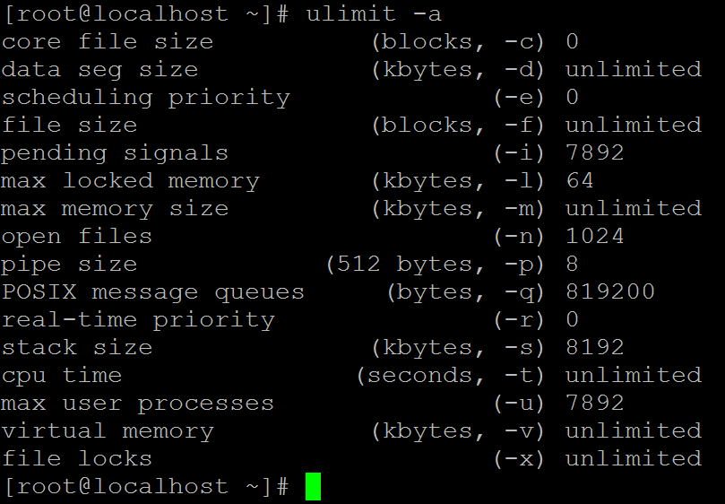
Resource Limits
The OS imposes limits for certain system resources it can use.
Applicable to a specific process.
The “ulimit” shell built-in can be used to set/query the status.
“ulimit –a” returns the user limit values

Slide 45
Hard and Soft Limits
-c → Maximum size of “core” files created.
-f → Maximum size of the files created.
-l → Maximum amount of memory that can be locked using mlock() system call.
-n → Maximum number of open file descriptors.
-s → Maximum stack size allowed per process.
-u → Maximum number of processes available to a single user.
Each resource has two limits –Hard and Soft
Hard Limits
Absolute limit for a particular resource. It can be a fixed value or “unlimited”
Only superuser can set hard limit.
“ulimit” command has –H or –S option to set hard/soft limits. Default is soft limit.
Hard limit cannot be increased once it is set.
Soft Limits
User-definable parameter for a particular resource.
Can have a value of 0 till <hard limit> value.
Any user can set soft limit.
Limits are inherited (the new values are applicable to the descendent processes).

Slide 46
Resource Limitation
getrlimit()/setrlimit() are system-call interfaces for getting and setting resource limits.
Syntax
getrlimit(<resource>, &r)
setrlimit (<resource>, &r)
where r is of type “struct rlimit”
int getrlimit(int resource, struct rlimit *rlim);
int setrlimit(int resource, const struct rlimit *rlim);
int prlimit(pid_t pid, int resource, const struct rlimit *new_limit, struct rlimit *old_limit);
struct rlimit {
rlim_t rlim_cur; /* Soft limit */
rlim_t rlim_max; /* Hard limit (ceiling for rlim_cur) */
};

Slide 47
Resource Usage
struct rusage {
struct timeval ru_utime; /* user CPU time used */
struct timeval ru_stime; /* system CPU time used */
long ru_maxrss; /* maximum resident set size */
long ru_ixrss; /* integral shared memory size */
long ru_idrss; /* integral unshared data size */
long ru_isrss; /* integral unshared stack size */
long ru_minflt; /* page reclaims (soft page faults) */
long ru_majflt; /* page faults (hard page faults) */
long ru_nswap; /* swaps */
long ru_inblock; /* block input operations */
long ru_oublock; /* block output operations */
long ru_msgsnd; /* IPC messages sent */
long ru_msgrcv; /* IPC messages received */
long ru_nsignals; /* signals received */
long ru_nvcsw; /* voluntary context switches */
long ru_nivcsw; /* involuntary context switches */
};
int getrusage(int who, struct rusage *usage);
getrusage() returns resource usage measures
for who, which can be one of the following:
RUSAGE_SELF
RUSAGE_CHILDREN
RUSAGE_THREAD
sysconf - get configuration information at
run time:
long sysconf(int name);
Example: ret= sysconf(_SC_CLK_TCK);
On success it returns the value of the given system limits.

Slide 48
Multi Threading
Thread is a sequential flow of control through a program.
If a process is defined as a program in execution then a thread is defined as a function in execution.
If a thread is created, it will execute a specified function.
Two type of threading: 1. Single Threading and 2. Multi threading
The created threads within a process share 1. instructions of a process 2. process address space and data 3. open file descriptors 4. Signal Handlers 5. pwd, uid and gid
The created threads maintain it’s own
1. thread identification number (tid); 2. pc, sp, set of registers 3. stack
4. priority of the threads
5. scheduling policy
Advantages of Threads:
Takes less time for creation of a new thread, termination of a thread and communication between threads are easier.

Slide 49

Advantages
Improve application responsiveness
Use multiprocessors more efficiently
Improve program structure
use fewer system resources
Specific applications in uniprocessor machines
Applications
A file server on a LAN
GUI
web applications
Display on monitor
Kernel
Auto Saving
Input from keyboard

Slide 50
Thread Creation
#include <pthread.h>
void thread_func(void) { printf(“ Thread id is %d”, pthread_self()); }
main ( ) {
pthread_t mythread; pthread_create ( &mythread, NULL, (void *) thread_func, NULL);
}
This needs to be compiled as follows...$gcc pthread.c –lpthread
pthread_t is type-defined as unsigned long int. It takes the thread address as the first argument, the second argument is used to set the attributes for the thread-like stack size, scheduling policy, priority; if NULL is specified, then it takes default values for the attributes.
The third argument is the function that the thread should execute when created. The fourth argument is the argument for the thread function. If that function has a single argument to be passed, we can specify it here. If it has more than one argument, then we have to use a structure and declare all the arguments and pass the address of the structure.

Slide 51
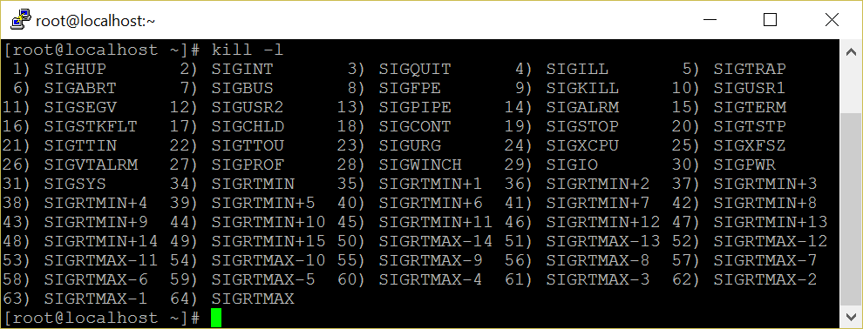
Linux Signals

Slide 52
Introduction
Signals are a fundamental method for inter process communication and are used in everything from network servers to media players.
A signal is generated when
an event occurs (timer expires, alarm, etc.,)
a user quota exceeds (file size, no of processes etc.,)
an I/O device is ready
encountering an illegal instruction
a terminal interrupt like Ctrl-C or Ctrl-Z.
some other process send ( kill -9 pid)
Each signal starts with macro SIGxxx.
Each signal may also specifies with its integer number
For help: $ kill –l , $ man 7 signal
When a signal is sent to a process, kernel stops the execution and "forces" it to call the signal handler.
When a process executes a signal handler, if some other signal arrives the new signal is blocked until the handler returns.

Slide 53
Signal Vs Interrupt
Interrupt
Signal
Process
Process
Process
Kernel
Kernel
Kernel
process
Illegal instruction
Hard ware
$ kill -9 pid
I/O operation (ex: mouse click)

Slide 54
signal System Call
How a process receives a signal, when it is
executing in user mode
executing in kernel mode
not running
in interruptible sleep state
in uninterruptible sleep state
When a signal occurs, a process could
Catch the signal
Ignore the signal
Execute a default signal handler
Two signals that cannot be caught or ignored
SIGSTOP
SIGKILL
signal system call is used to catch, ignore or set the default action of a specified signal.
int signal (int signum, (void *) handler);
It takes two arguments: a signal number and a pointer to a user-defined signal handler.
Two reserved predefined signal handlers are :
SIG_IGN
SIG_DFL

Slide 55
signal System Call
sigaction ( ) is ame as signal( ) but it has lot of control over a given signal.
The syntax of sigaction is:
int sigaction ( int signum, const struct sigaction *act, struct sigaction *oldact);
signum, is a specified signal
act is used to set the new action of the signal signum;
oldact is used to store the previous action, usually NULL.
Kill system call is used to send a given signal to a specific process
int kill ( pid_t process_id, int signal_number );
it accepts two arguments, process ID and signal number
If the pid is positive, the signal is sent to a particular process.
If the pid is negative, the signal is sent to the process whose group ID matches the absolute value of pid.

Slide 56
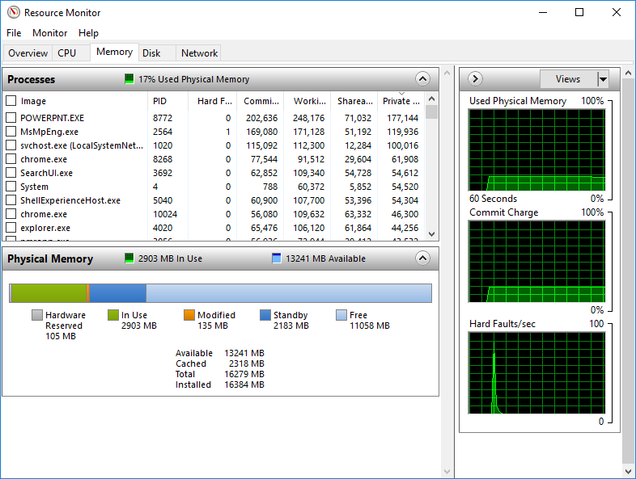
Memory Management

Slide 57
Virtual Memory
Large address space: virtual memory is many times larger than the physical memory in a system.
For a 32 bit OS, the virtual memory size will be 2 to the power of 32 i.e 4GB. But the RAM size may be much smaller.
Each process has a separate virtual address space.
Each process space is protected from other processes.
It supports shared virtual memory, i.e more than one process can share a shared page.
Uses paging technique.
Memory management: one of the most important kernel subsystems
Virtual Memory: Programmer need not to worry about the size of RAM (Large address space)
Static allocation: internal Fragmentation
Dynamic allocation: External Fragmentation
Avoid Fragmentation: Thrashing -overhead

Slide 58
Page Table
Translate a process virtual address into physical address since processor use only virtual address space
The size of a page table is normally size of a page
if it is 4kb, each page address size is 4byte, so 1024 page entries in a page table.
holds info about
Whether valid page table or not?
PFN
access control information
Stored in TLB (Translation Look-aside Buffer)
Hard ware support (MMU, TLB) is required.
Fair share allocation
static allocation
Minimize internal fragmentation
identified by a PFN (Page Frame Number)
virtual address is split into two parts namely an offset and a virtual page frame number.

Slide 59
Memory Mapping
Executable image spilt into equal sized small parts (normally a page size)
Virtual memory assigns virtual address to a each part
Linking of an executable image into a process virtual memory
Swapping
Swap space is in hard disk partition
If a page is waiting for certain event to occur, swap it.
Use physical memory space efficiently
If there is no space in Physical memory, swap LRU pages into swap space
Demand Paging - don't load all the pages of a process into memory
Load only necessary pages initially
if a required page is not found, generate page fault then the page fault handler brings the corresponding page into memory.

Slide 60
Kernel Data Structure
Source Code: /usr/src/linux-4.12/mm
/usr/src/linux-4.12/include/linux
virtual memory is represented by an mm_struct data structure
it has pointers to vm_area_struct data structure
created when an executable image is mapped with the process virtual address
has starting and end points of virtual memory
represents a process's image like text, data and stack portion
has control access info
mm_types.h
struct mm_struct {
struct vm_area_struct *mmap; /* list of VMAs */
…………………………………….
struct vm_area_struct {
/* The first cache line has the info for VMA tree walking. */
unsigned long vm_start;
unsigned long vm_end;
/* linked list of VM areas per task, sorted by address */
struct vm_area_struct *vm_next, *vm_prev;
…………………………………….

Slide 61
Virtual to Physical Memory Translation
Process X
Process Y
VPFN 6
VPFN 6
VPFN 5
Process X
page tables
Process Y
page tables
VPFN 5
VPFN 4
PFN 4
VPFN 4
VPFN 3
PFN 3
VPFN 3
VPFN 2
PFN 2
VPFN 2
VPFN 1
PFN 1
VPFN 1
VPFN 0
PFN 0
VPFN 0
Virtual memory
Physical Memory
Virtual memory

Slide 62

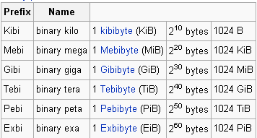


x86-64 Virtual Memory Layout
$pmap –x <pid>
0xFFFF FFFF FFFF FFFF
Kernel Space
128 TiB
0xFFFF 8000 0000 0000
Reserved by hardware
for future expansion
(not to scale)
16 EiB - 256 TiB
0x0000 7FFF FFFF FFFF
User Space
(Application’s code and data)
128 TiB
0x0000 0000 0000 0000

Slide 63
Virtual to Physical Transition
63
47
VIRTUAL PAGE NUMBER
OFFSET
0
RESERVED
36 bits
12 bits
Translation
47
0
36 bits
12 bits
PHYSICAL PAGE NUMBER
OFFSET

Slide 64
Memory Architecture – Page Table
63
47
VIRTUAL PAGE NUMBER
OFFSET
0
RESERVED
36 bits
12 bits
%cr3
36 bits
PAGE TABLE
1
(PTE for the virtual page number)
47
0
36 bits
12 bits
PHYSICAL PAGE NUMBER
OFFSET

Slide 65
Page Table Hierarchy on x86-64
63
47
PML4E
PDPTE
PDE
PTE
OFFSET
0
RESERVED
9 bits
9 bits
9 bits
9 bits
12 bits
512 entry
512 entry
512 entry
512 entry
4096 byte
page global directory
Page middle directory
page directory
page table
page
36 bits
%cr3

Slide 66
Memory Architecture
63
47
VIRTUAL PAGE NUMBER
OFFSET
0
RESERVED
36 bits
12 bits
TLB lookup
Add entry to TLB and continue…
Mapping cached in TLB
Map & load page into RAM
NO
(TLB MISS)
Lookup page in process page table
YES
YES
(TLB HIT
Is page mapped in RAM?
NO
Page Fault
47
0
36 bits
12 bits
PHYSICAL PAGE NUMBER
OFFSET

Slide 67
$ free -m
Memory 8 GB
buffers 30 MB
used
472MB
free
7115 MB
cached
188 MB
 | total | used | free | shared | buffers | cached
Mem: | 7806 | 691 | 7115 | 0 | 30 | 188
-/+ buffers/cache: |  | 472 | 7334
Swap: | 1999 | 0 | 1999
Mem: used = 472 + 30 + 188 = 690

Slide 68
Walk Through Program Execution
Execute
./a.out
Memory
Mapping
P
R
O
C
C
E
S
S
O
R
Virtual
Memory
Demand
paging
Page
Table
VPFN
Page
Table
Load
VPFN
execute
Page Fault
Exit
Swap
Space
Hard
Disc

Slide 69
Thank You

Slide 70
Overview
of
LINUX Device Drivers

Slide 71
Agenda
Introduction to Device Drivers
Brief Introduction of Linux OS and Its Internals
Classes of Devices
Device Driver Classifications
Kernel Modules Vs Applications
Major and Minor numbers
Device Driver Entry Points
Developing and Compiling a Simple Module
Loading and Removing a Module
Character Device Driver
I/O Memory Allocation
File Structure
File Operations Structure
Transfer of data to / from Device Driver
Design of a Simple Character Device Driver

Slide 72
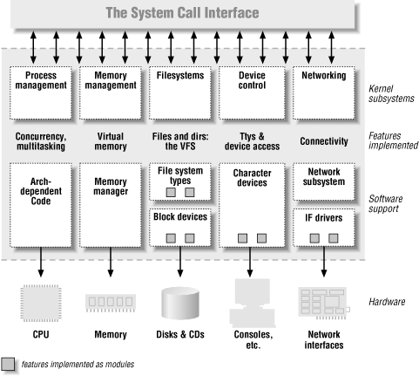
Linux Kernel Architecture

Slide 73
Device Driver Introduction
A device driver is a collection of functions that accept general requests for I/O operations and manipulate the device to perform the requested operations.
Under UNIX every device is managed by device driver functions.
The group of functions is compiled and attached as part of the UNIX kernel.

Slide 74
Device Driver Introduction
Device Drivers are the translators of the unix operating system kernel. They stand between the kernel and peripherals, translating requests for work into activity by the hardware.
A device driver is a “C’ program that controls a device.
Drivers are distinct "black boxes" that make a particular piece of hardware respond to a well-defined internal programming interface.

Slide 75
Device Driver Classifications
Statically linked driver: whose object code is linked with the kernel. The code of such device driver is physically contained in the kernel and therefore loaded in memory when the system boots.
Dynamically linked driver: whose object code is NOT linked with the kernel. The code of such device driver is NOT contained in the kernel, and the device driver is loaded and unloaded as and when required.

Slide 76
Dynamically Linked Driver
The device driver programming interface is such that drivers can be built separately from the rest of the kernel, and "plugged in" at runtime when needed.
Each piece of code that can be added to the kernel at runtime is called a module. For example: device drivers, file systems.
Each module is made up of object code that can be dynamically linked to the running kernel or removed from the running kernel by the appropriate command.

Slide 77
Fundamental Concept
Write kernel code to access the hardware, but don't force particular policies on the user, since different users have different needs.
The driver should deal with making the hardware available, leaving all the issues about how to use the hardware to the applications.
The kernel is non preemptive. Kernel functions do not get context switched. Thus, you need not do lots of messy locking on variables.
But, if one of the driver routines goes into an infinite loop, the machine will hang. If the routine takes too long, the machine will appear to pause.
None of the libc functions are available, but some of them are duplicated.

Slide 78
Kernel Modules Vs Applications
Applications performs a single task from beginning to end, A module registers itself in order to serve future requests.
Application call functions resolves external references using appropriate lib functions during link stage, whereas modules are linked only to the kernel, and only functions it can call are exported by kernel.
Since no library is linked to modules, source file should never include usual header files.
Segmentation fault is harmless during application development but kernel fault is fatal at least to the current process, if not for the whole system.

Slide 79
Kernel Modules Vs Applications
User activities are performed by means of a set of standardized calls that are independent of the specific driver.
Mapping those calls to device-specific operations that act on real hardware is then the role of the device driver.
However, unlike a C program, you do not link a device driver into an executable program as it does not have a main() function - meaning that a device driver does not have a single entry point.

Slide 80
Namespace Pollution
Kernel programmer must be aware of and avoid namespace pollution.
The programmer is to find unique names for new symbols.
Namespace collisions can lead module loading failures.
The best approach for preventing namespace pollution is to declare all your global variables as static.

Slide 81
Major and Minor Numbers
A driver never actually knows the name of the device being opened, just the device number—and users can play on this indifference to names by aliasing new names to a single device for their own convenience.
If you create two special files with the same major/minor pair, the devices are one and the same, and there is no way to differentiate between them.

Slide 82
Major and Minor Numbers
The major number identifies the driver associated with the device. It is a small integer that serves as the index into a static array of char drivers.
The kernel uses the major number at open time to dispatch execution to the appropriate driver.
The minor number is used only by the driver specified by the major number. It is common for a driver to control several devices, the minor number provides a way for the driver to differentiate among them.

Slide 83
Major and Minor Numbers
$ ls -l /dev/hda*
brw-rw---- 1 root disk 3, 0 Mar 24 2001 /dev/hda
brw-rw---- 1 root disk 3, 1 Mar 24 2001 /dev/hda1
brw-rw---- 1 root disk 3, 2 Mar 24 2001 /dev/hda2
$ ls –l /dev/lp*
crw-rw---- 1 root lp 6, 0 Mar 24 2001 lp0
crw-rw---- 1 root lp 6, 1 Mar 24 2001 lp1
crw-rw---- 1 root lp 6, 2 Mar 24 2001 lp2

Slide 84
Current Process Information
#include <linux/sched.h>
One of the most important header files.
struct task_struct *current;
The current process.
for ex: current - > pid; current - > comm; etc,.
The process ID and command name for the current process.
MODULE_AUTHOR (“ Linus Torvald ”);
Puts the author’s name into the object file.
MODULE_DESCRIPTION (“simple character device driver”);
Puts a description of the module into the object file.
$modinfo –a module.o : To check author name.
$modinfo –d module.o : To check module description.

Slide 85
Dynamic Memory Allocation
- obtains a memory area using kmalloc and releases it using kfree.
- behave like malloc except takes an additional argument, the priority.
- usually, a flag of GFP_KERNEL or GFP_ATOMIC or GFP_USER.
void *kmalloc (unsigned int size, int priority);
void kfree (void *obj);

Slide 86
Driver Entry Points
A device driver has a collection of functions known as entry points. Some of the entry points are :
open()
release()
llseek()
read() (used for character device drivers only)
write() (used for character device drivers only)
strategy() (used for block device drivers only)
ioctl ()
poll()

Slide 87
Input-Output Interface
open()
close()
read()
write()
ioctl()
Linux kernel interface
Based on the “path”, identify the device.
Call the corresponding device function
Device1
D_open1
D_close1
D_read1
D_write1
D_ioctl1
Device2
D_open2
D_close2
D_read2
D_write2
D_ioctl2
Device3
D_open3
D_close3
D_read3
D_write3
D_ioctl3
Device4
D_open4
D_close4
D_read4
D_write4
D_ioctl4

Slide 88
Developing and Compiling a Simple Module
Need root permission to load or remove the module.
$insmod ./char.o
Module Insertion Successful.
$rmmod char
Module unloading Successful.
Output of printk is shown because, after loading the module it can link to the kernel and can access the kernel's public symbols (functions and variables).
#include <linux/kernel.h>
int my_init (void)
{
printk ("Module Insertion Successful\n");
return 0;
}
void my_cleanup (void)
{
printk ("Module unloading Successful \n");
}
module_init (my_init);
module_exit (my_cleanup);

Slide 89
$lsmod
whether the module is loaded or not can be checked by
$cat /proc/modules (or) lsmod
Module Size No.of User
nfsd 69696 8
------ ------ ---
usbcore 49664 1
$cat /proc/devices
Character devices:
1 mem
----
10 misc
Block devices:
1 ramdisk
2 fd

Slide 90
Switch Table
The Unix kernel maintains a set of data structures known as : Switch Table
These data structures are used to locate and invoke the entry points of a device driver.
Each switch table is an array of structures. Each structure contains a number of function pointers.

Slide 91
Locating Driver Entry Points
To decide which element of the switch table should be used, the system uses the “major device number”.
Then the system decides which entry point of the element should be used.
This depends upon the system call used by the process. If the process used “open” system call, then the “open” entry point is used and so on...

Slide 92
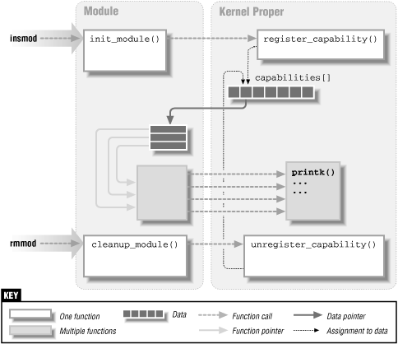

Slide 93
Device Registration
The init ( ) is called when the device driver is loaded in memory.
Registers other entry points of the driver with the kernel.
Registers the resources like major number, IRQ, IO ports etc., which are needed by the driver with the kernel.
int init_module ( ) {
register device;
}
int register_chrdev (unsigned int major, const char *name, struct file_operations *fops);
Some of the numbers such as 60 – 63, 120 - 127 and 240 – 254 are not used for the standard devices, and used for experimental purpose.

Slide 94
cleanup_module ( )
void cleanup_module ( ) {
unregister the device and release the major number;
}
int unregister_chrdev (unsigned int major, const char *name);
struct file, defined in <linux/fs.h>, is the most important data structure used in device drivers.
The file structure represents an open file. It is not specific to device drivers, every open file in the system has an associated struct file in kernel space.

Slide 95
File Structure
It is created by the kernel on open and is passed to any function that operates on the file, until the last close. After all instances of the file are closed, the kernel releases the data structure.
struct file {
struct file_operations *f_op;
unsigned int f_flags;
mode_t f_mode;
loff_t f_pos;
void *private_data;
………………………………..
};

Slide 96
File Structure
mode_t f_mode
The file mode identifies the file as either readable or writable (or both).
loff_t f_pos
The current reading or writing position.
unsigned int f_flags
A driver needs to check the flag for non blocking operation. The flags are defined in the header <linux/fcntl.h>.

Slide 97
File Structure
struct file_operations *f_op
The operations associated with the file.
void *private_data
The driver is free to make its own use of the field or to ignore it. The driver can use the field to point to allocated data, but then must free memory in the release method.

Slide 98
file_operations Structure
An open device is identified internally by a file structure, and the kernel uses the file_operations structure to access the driver’s functions. The structure, defined in <linux/fs.h>, is an array of function pointers.
Each file is associated with its own set of functions The operations are mostly in charge of implementing the system calls such as open, read, llseek, and so on.
The file_operations structure has been slowly getting bigger as new functionality is added to the kernel.

Slide 99
file_operations Structure
struct file_operations fops = {
lseek,
read,
write,
readdir
select / poll
ioctl
open,
flush
release
};

Slide 100
file_operations Structure
The following list shows what operations appear in struct file_operations for the 2.4 series of kernels. The return value of each operation is 0 for success or a negative error code to signal an error.
loff_t (*llseek) (struct file *, loff_t, int);
The llseek method is used to change the current read/write position in a file. The loff_t is a “long offset”.
ssize_t (*read) (struct file *, char *, size_t, loff_t *);
used to retrieve data from the device. A non-negative
return value represents the number of bytes successfully read.
ssize_t (*write) (struct file *, const char *, size_t, loff_t *);
sends data to the device. The return value, if non-negative,
represents the number of bytes successfully written.

Slide 101
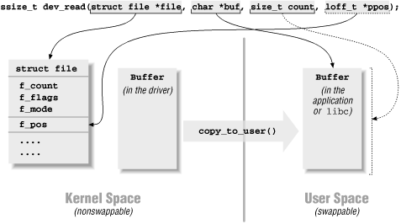
read for example

Slide 102
file_operations Structure
int (*readdir) (struct file *, void *, filldir_t);
This field should be NULL for device files; it is used for reading directories, and is only useful to file systems.
unsigned int (*poll) (struct file *, struct poll_table_struct *);
The poll method is the back end of two system calls, poll and select, both used to inquire if a device is readable or writable. Either system call can block until a device becomes readable or writable.
int (*ioctl) (struct inode *, struct file *, unsigned int cmd, unsigned long arg);
The ioctl system call offers a way to issue device-specific commands (like Formatting a track of a floppy disk, which is neither reading nor writing).

Slide 103
file_operations Structure
int (*mmap) (struct file *, struct vm_area_struct *);
mmap is used to request a mapping of device memory to a process’s address space.
int (*open) (struct inode *, struct file *);
When a device file is open, this entry point is called.
int (*flush) (struct file *);
The flush operation is invoked when a process closes its copy of a file descriptor for a device; Currently, flush is used only in the network file system (NFS) code.
int (*release) (struct inode *, struct file *);
This operation is invoked when the file structure is being released. Like open, release can be missing.*

Slide 104
Driver Kernel Communication
Any device operation is typically initiated by a process.
For example a process might use the read() system call to read 10 bytes for a file opened earlier, and store these 10 bytes in a local buffer.
The read() system call now finds out which device is associated with this request, the type of the device and the major device number associated with the device.
The read() system call then invokes the read() entry point of the device and supplies the address of the user (process) buffer to the device driver.
However, the user buffer is located in the process address space. Whereas the device driver executes in the kernel address space.

Slide 105
Transfer of Data To/From Drivers
To copy from user buffer to kernel buffer vice versa can be done by the following functions.
unsigned long copy_to_user(void *to, const void *from, unsigned long count);
unsigned long copy_from_user(void *to, const void *from, unsigned long count);

Slide 106
Device File Creation
The command to create a device node on a filesystem is mknod;
Superuser privileges are required for this operation. The command takes three arguments in addition to the name of the file being created. For example, the command
mknod /dev/dev1 c 254 0
creates a char device (c) whose major number is 254 and whose minor number is 0.
Note that once created by mknod, the special device file remains unless it is explicitly deleted.

